Slide 1


SOCIAL BUZZ: Analytics for IPO Launch and Successful Data Understanding

Slide 2


Today's agenda
Project recap
Problem
The Analytics team
Process
Insights
Summary

Slide 3

SOCIAL BUZZ
A tech unicorn looking to expand to IPO. Accenture is focusing to help in the following categories:
- Auditing data and understanding business insights
- Resources required for successful IPO launch
- Analyzing data to derive useful conclusions like top 5 categories, unique categories
Project Recap

Slide 4

Problem
Over 100000 posts
36,500,000 pieces of content per year!
Analyzing to find top 5 most popular categories of content

Slide 5



Sneha Singh
Data Analyst
The Analytics team
Marcus Rompton
Senior Principle
Andrew Fleming
Chief Technical Architect

Slide 6
Process
1
Data Understanding
2
Data Cleaning
3
Data Modeling
4
Data Analysis
5
Unfold Insights

Slide 7
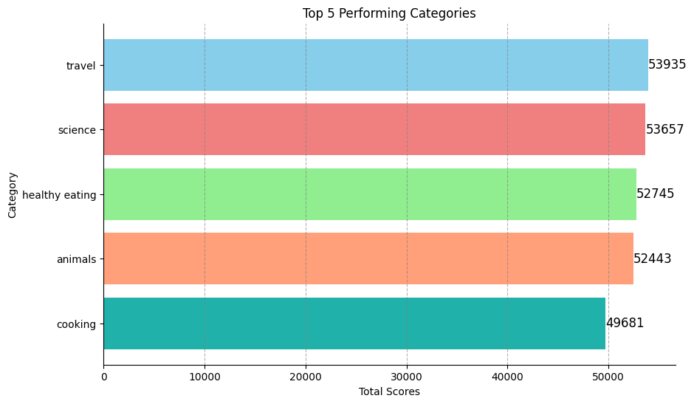

Insights

Slide 8
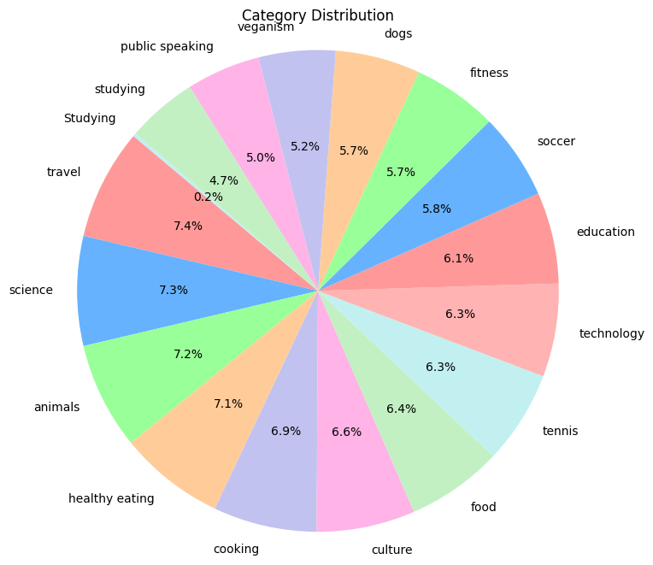
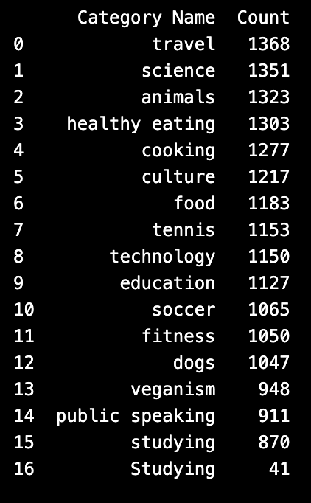
UNIQUE CATEGORIES
We found the following 17 unique categories and each category has the following number of reaction count:

Slide 9
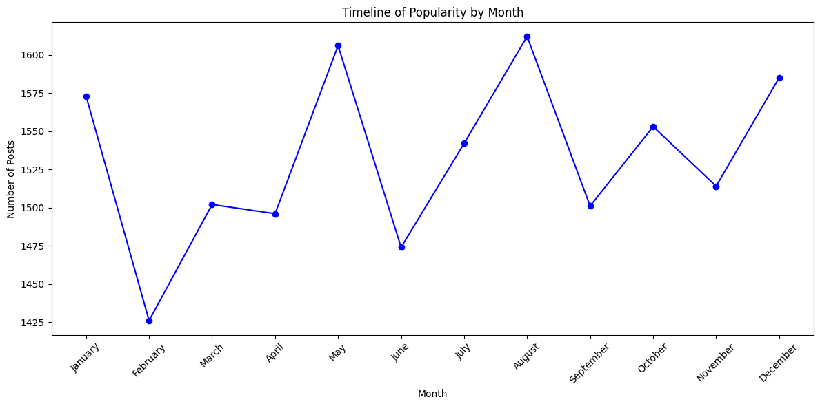
POPULARITY TIMELINE
We can see the popularity timeline of the posts as show in given graph. Here, we see August, i.e. Month 8 is the most popular month

Slide 10

The top 5 categories are: Travel, Science, Healthy Eating, Animals and Cooking
Summary
There exists 17 unique categories
August month is the most popular month in the content consumption

Slide 11

Thank you!
ANY QUESTIONS?

